Slide 1

Face Detection System Using Python
DEPARTMENT OF COMPUTER ENGINEERING
S.V.P’.S B.S. DEORE COLLEGE OF ENGINEERING , Dhule
2024-2025
Presented by:- Pratik Sanjay Pawar Guided by :-B.D.Patil Gopal Chandrakant Saindane
Yogesh Sanjeev Patil
Lalit Kishor Chaudhari

Slide 2
Building a real-time face detection system using Python, Flask, and OpenCV

Slide 3
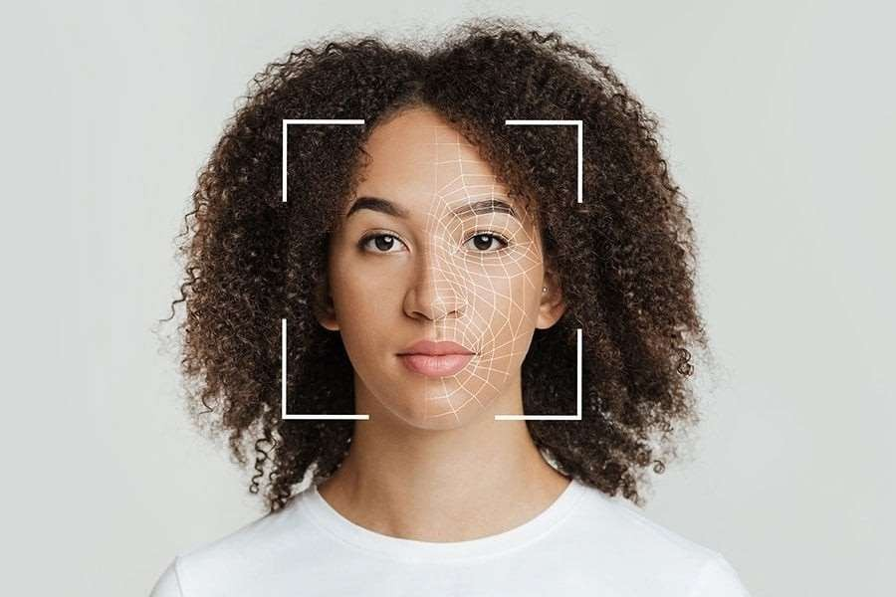
Introduction to face detection
In this presentation, we will explore real-time face detection and its applications. We'll utilize python, flask, and opencv to create an attendance system. This system will automatically detect faces and record attendance, enhancing efficiency in various environments

Slide 4
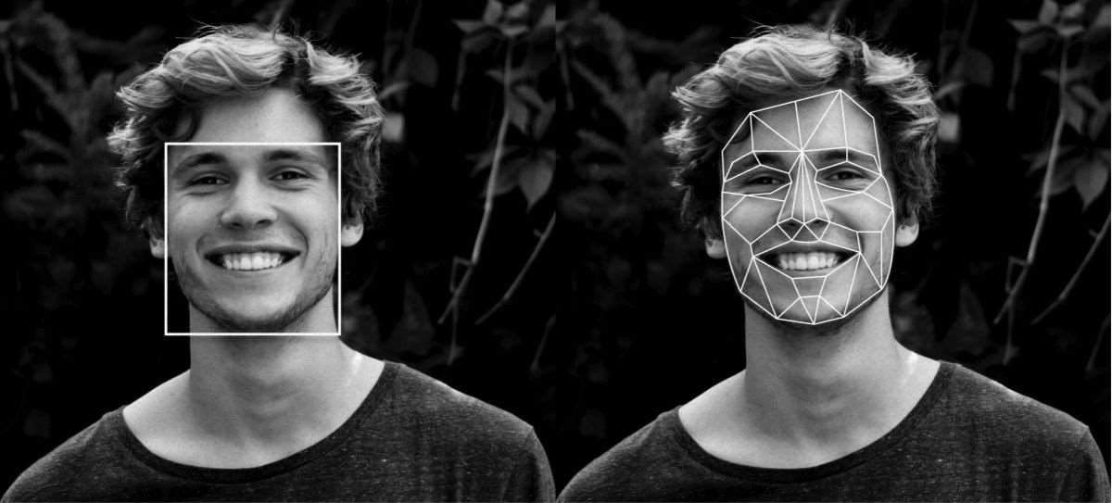
Understanding face detection
Face detection involves the identification of human faces in images or videos. It is crucial for applications like security, surveillance, and user interaction. We'll discuss the underlying algorithms that make this possible, focusing on haar cascades and deep learning techniques.

Slide 5

Setting up the environment
To begin, we need to set up our development environment. This includes installing python, flask, and opencv. Ensure that you have the latest versions to avoid compatibility issues. We will also discuss the necessary libraries and their installation.

Slide 6

Building The Flask Application
Flask is a lightweight web framework that allows us to build web applications easily. In this slide, we will outline the steps to create a basic flask app that serves our face detection functionalities. We will focus on routing and templates

Slide 7

Integrating Opencv For Detection
Opencv is a powerful library for computer vision. We will integrate it into our flask application to handle real-time video streams. This section will cover how to capture video, process frames, and detect faces using opencv's built-in functions.

Slide 8
Creating The Attendance System
The attendance system will leverage the face detection capabilities to record attendance automatically. We will discuss how to maintain a database of recognized faces and log attendance in real-time. This involves using sqlite or other database solutions.

Slide 9
User Interface Design
A User-friendly interface is crucial for our application. We will explore how to design a simple yet effective UI using HTML, CSS, and JavaScript. The focus will be on displaying the video feed and attendance logs in a clear format.

Slide 10
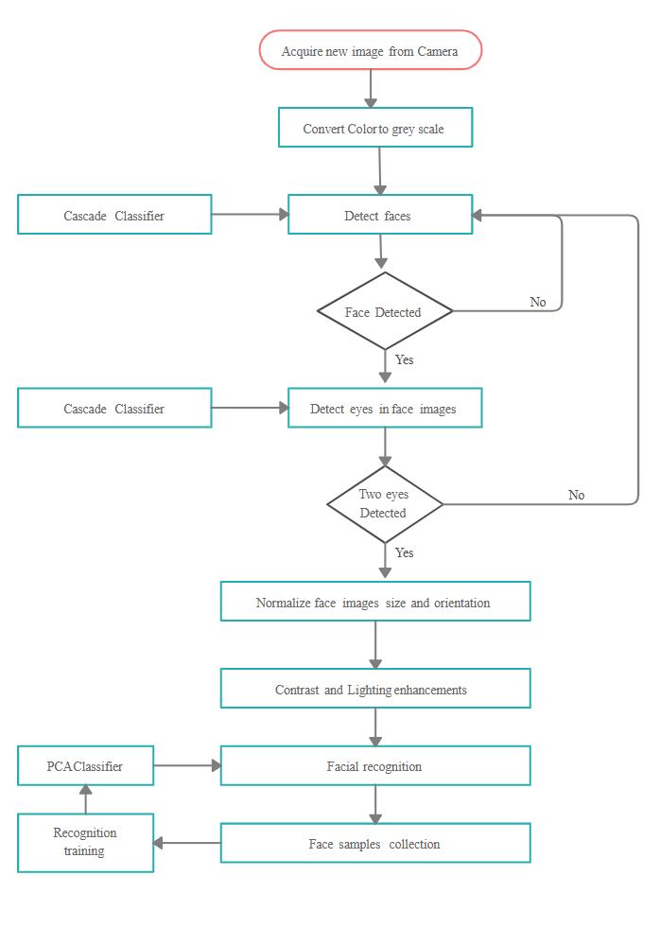
Dfd Dig.

Slide 11
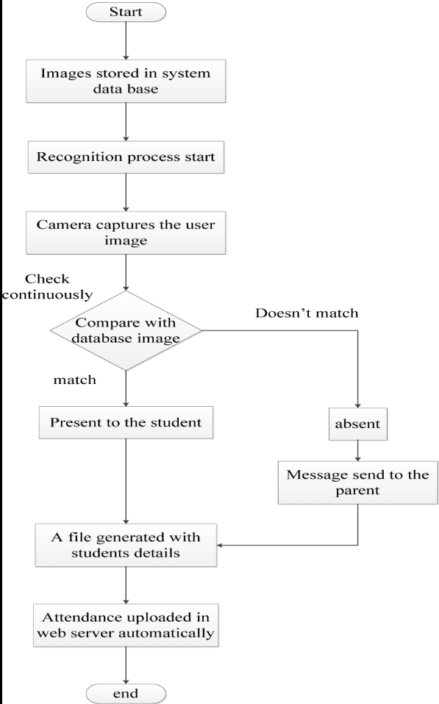
Flow chart

Slide 12
Conclusion And Future Work
In conclusion, we have built a real-time face detection and attendance system using python, flask, and opencv. Future work may involve enhancing accuracy, implementing security features, and exploring machine learning for improved detection. Thank you for your attention!

Slide 13
Thanks !

